Slide 1
Module 3
Hosting Web Applications on the Azure Platform
Notes:
20532C
3: Hosting Web Applications on the Azure Platform

Slide 2
Module Overview
Azure Web Apps Hosting Web Applications in Azure Configuring an Azure Web App Publishing an Azure Web App Lab Overview
Notes:
20532C
3: Hosting Web Applications on the Azure Platform

Slide 3
Lesson 1: Azure Web Apps
Azure Web Apps Overview Web App Tiers Prebuilt Web App Templates Demonstration: Creating a Web App
Notes:
20532C
3: Hosting Web Applications on the Azure Platform

Slide 4
Azure Web Apps Overview
Simple, scalable hosting for websites in Windows Azure with the following benefits:
Provides a quick way to host your web application in the cloud
Allows you to scale your web app without being required to redesign for scalability
Integrates with Visual Studio
Provides an open platform for many different programming languages
Notes:
Emphasize how simple it is to deploy a web application to Azure Web Apps.
You can also talk about what scalability means with respect to a Web App in Azure. Unlike with cloud services, you can easily scale the number of instances and the size of a Web App without having to redesign your web application to make it completely modular.
20532C
3: Hosting Web Applications on the Azure Platform

Slide 5
Web App Tiers
Web Apps can be scaled to run in one of the three following modes:
Free
Shared
Shared compute resources
No upper-limit to bandwidth and CPU time
Additional customization options
Limited customization options
Limited bandwidth and CPU time
Shared compute resources
Notes:
20532C
3: Hosting Web Applications on the Azure Platform

Slide 6
Web App Tiers (continued)
Web Apps can be scaled to run in one of the three following modes:
Basic
Reserved instance for multiple web applications
Websites are pooled under the same instance
Standard
Reserved instance for multiple web applications
Websites are pooled under the same instance
Supports auto-scale
Notes:
20532C
3: Hosting Web Applications on the Azure Platform

Slide 7
Web App Tiers (continued)
To host multiple Web Apps, use a Standard or Basic Web Hosting Plan
Reserves a virtual machine for your Websites
Billed based on number of virtual machine instances and not number of Websites
Standard
Basic
Shared
Free
Notes:
For simple Web Apps, you might overestimate the number of instances and the size that is required. Mention that it is possible to host many Web Apps instances in a single small size Standard App Service Plan. This is a common tactic to save on hosting costs.
20532C
3: Hosting Web Applications on the Azure Platform

Slide 8
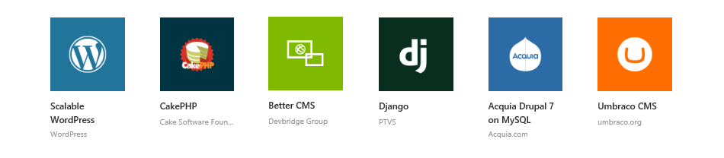
Prebuilt Web App Templates
Create a Web App using a pre-built template from the Azure Marketplace.
There are over 30 open source applications, frameworks and templates in the Marketplace:
Notes:
20532C
3: Hosting Web Applications on the Azure Platform

Slide 9
Demonstration: Creating a Web App
In this demonstration, you will learn how to:
Create a Web App instance by using the Azure Portal
Create a SQL Database instance by using the Portal
Manage the Web App and SQL Database instances as a Resource Group
Notes:
Preparation Steps
Note: The demo steps are accurate as of the publishing date of this course. To view the latest demo steps, visit the GitHub repository for the course.
For this demonstration, you will use the available host machine. Before you begin this demonstration, you must complete the following step:
Verify that you received credentials to sign in to the Azure portal from your training provider. You will use these credentials and the Azure account throughout the labs in this course.
20532C
3: Hosting Web Applications on the Azure Platform

Slide 10
Lesson 2: Hosting Web Applications in Azure
Web App Configuration App Service Plans
Notes:
20532C
3: Hosting Web Applications on the Azure Platform

Slide 11
Web App Configuration
The Web App deployment package and it’s configuration are both stored in an external store.
App Settings and Connection Strings are intercepted and changed in the application during startup
Applications can be scaled by:
Creating IIS web sites using the Web Deploy package
Applying configuration options from the external store
Notes:
20532C
3: Hosting Web Applications on the Azure Platform

Slide 12
Web App Configuration (continued)
Web Apps share functionality with IIS web sites
For Free and Shared instances, Web Sites are implemented similar to IIS web sites
For Standard instances, a reserved virtual machine is made available and each individual Website is similar to an IIS web site
Azure Websites can also be managed remotely using the IIS Manager
Notes:
20532C
3: Hosting Web Applications on the Azure Platform

Slide 13
App Service Plans
App Service Plans can logically group Web Apps within a subscription.
Characteristics such as features, capacity and tiers are shared amongst the Website instance in the group.
Multiple App Service Plans can exist in a single Resource Group and multiple Web Appscan exist in a single App Service Plan.
Notes:
You can suggest this article to students who want to dive deeper into App Service Plans.
Reference Links: http://go.microsoft.com/fwlink/?LinkID=510178
20532C
3: Hosting Web Applications on the Azure Platform

Slide 14
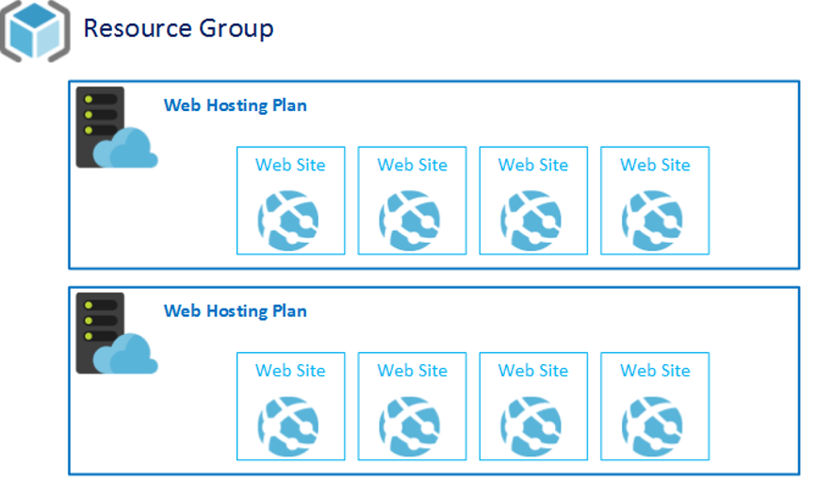
App Service Plans (continued)
App Service Plan
App Service Plan
Notes:
20532C
3: Hosting Web Applications on the Azure Platform

Slide 15
App Service Plans (continued)
App Service Plans are a required parameter when creating a new Web App instance.
You can chose to add a new Web App to an existing plan.
You can also define a new App Service Plan as a part of creating a new Web App.
Notes:
20532C
3: Hosting Web Applications on the Azure Platform

Slide 16
Lesson 3: Configuring an Azure Web App
AlwaysOn Domain Names Autoscaling Web Apps Demonstration: Autoscaling a Web App
Notes:
20532C
3: Hosting Web Applications on the Azure Platform

Slide 17
AlwaysOn
Only available for Basic/Standard tier
Ideal for continuous web jobs
Generates a simple HTTP request regularly
Intended as a heartbeat to make sure that the Web App does not recycle the app pool
Prevents Web Apps from being unloaded and forced to rebuild on next request.
Notes:
You can describe the scenarios where AlwaysOn can be used, such as web jobs that operate over data continuously. You also can discuss the impact of keeping the application warm instead of loading and unloading the site.
20532C
3: Hosting Web Applications on the Azure Platform

Slide 18
Domain Names
Standard domain
[http/https]://<sitename>.azurewebsites.net
In Shared, Basic or Standard mode, you can configure the Web App to use a custom domain
This involves managing the A and CNAME records with your registrar
Traffic Manager supports custom domain names
Notes:
Configuring Azure Web App Custom Domain Name
Reference Links: http://go.microsoft.com/fwlink/?LinkID=510179
20532C
3: Hosting Web Applications on the Azure Platform

Slide 19
Autoscaling Web Apps
Scaling rules are specific to a schedule
Performance scaling can be configured using various metrics:
Memory
HTTP Queue
Disk Queue
Data In
Data Out
Metrics
CPU
Notes:
Deep-Dive into Web App Scaling:
Reference Links: http://go.microsoft.com/fwlink/?LinkID=510177
Do not spend a lot of time describing the methods on this slide. These specific methods can change as the portal is updated.
Mention that autoscaling is available only for Standard hosting plans.
20532C
3: Hosting Web Applications on the Azure Platform

Slide 20
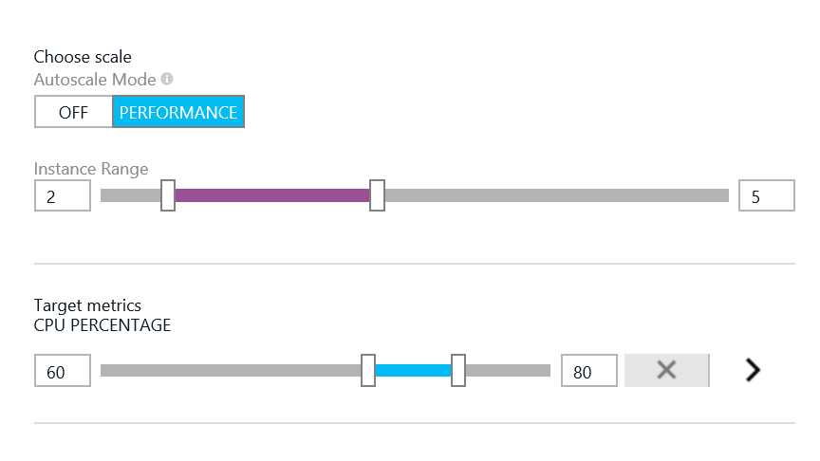
Performance Scaling
The Instance Range setting defines a minimum and maximum quantity of instances
You can use the CPU Percentage setting to set a CPU range
Minimum defines a threshold when instances should be removed
Maximum defines a threshold when instanced should be added
Notes:
Provide examples of situations where you might want to autoscale your Web App by utilization. A good example will be a Web App with an unpredictable usage pattern that is bursts.
20532C
3: Hosting Web Applications on the Azure Platform

Slide 21
Demonstration: Autoscaling a Web App
In this demonstration, you will learn how to:
Enable autoscale for a Web App
Notes:
Preparation Steps
Note: The demo steps are accurate as of the publishing date of this course. To view the latest demo steps, visit the GitHub repository for the course.
For this demonstration, you will use the available host machine. Before you begin this demonstration, you must complete the following step:
Verify that you received credentials to sign in to the Azure portal from your training provider. You will use these credentials and the Azure account throughout the labs in this course.
20532C
3: Hosting Web Applications on the Azure Platform

Slide 22
Lesson 4: Publishing an Azure Web App
The Web Deploy Protocol Demonstration: Managing Application Settings
Notes:
20532C
3: Hosting Web Applications on the Azure Platform

Slide 23
The Web Deploy Protocol
WebDeploy simplifies deployment of Web applications and Web Sites to IIS servers by providing a standard package format
Packages can be installed manually using IIS Manager, command line tools or PowerShell
Packages can be remotely installed by using the IIS instance remote deployment service
Visual Studio and WebMatrix can deploy a web application to a Web Deploy endpoint
Notes:
Focus on how you can use Web Deploy to create a package for your Web App. You can use the Web Deploy package to specify not only the content and files for your web application, but also the configuration settings that should be changed on the target IIS instance. You also can specify the possible changes and migrations to external resources such as SQL Server. After you specify these changes and setting, an administrator can directly deploy the Web App on a machine with IIS or remotely deploy it by using the IIS Web Management Service (WMSvc).
Web Apps use Web Deploy as the preferred method for publishing a web application.
20532C
3: Hosting Web Applications on the Azure Platform

Slide 24
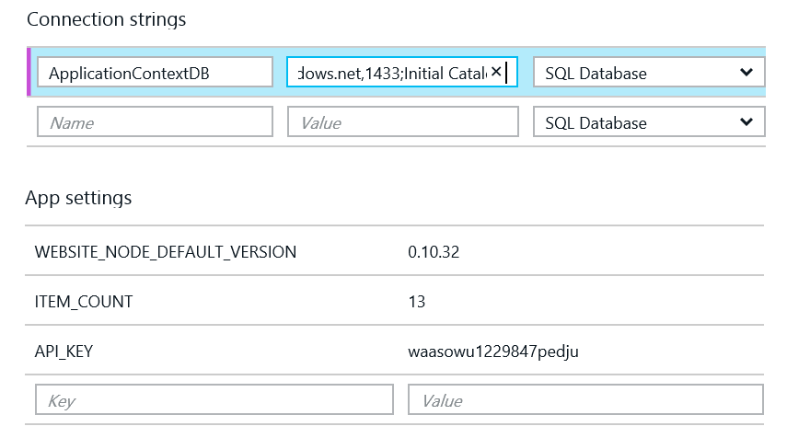
App Settings and Connection Strings
Application settings and connection strings can be managed in the portal.
Connection strings are hidden by default.
Notes:
Mention how these settings are injected by the host into an ASP.NET web application during startup. It is possible to access the appsettings and connectionStrings variables before these settings are injected.
These augment the values in your Web.config file appSettings and connectionStrings element[s].
20532C
3: Hosting Web Applications on the Azure Platform

Slide 25
Demonstration: Managing Application Settings
In this demonstration, you will learn how to:
Manage connection strings for a Web App
Manage app settings for a Web App
Notes:
Preparation Steps
Note: The demo steps are accurate as of the publishing date of this course. To view the latest demo steps, visit the GitHub repository for the course.
For this demonstration, you will use the available host machine. Before you begin this demonstration, you must complete the following step:
Verify that you received credentials to sign in to the Azure portal from your training provider. You will use these credentials and the Azure account throughout the labs in this course.
20532C
3: Hosting Web Applications on the Azure Platform

Slide 26
Lesson 5: Lab Overview
Demonstration: Contoso Events Walkthrough
Notes:
20532C
3: Hosting Web Applications on the Azure Platform

Slide 27
Demonstration: Contoso Events Walkthrough
In this demonstration, you will view the following sections of the Contoso Events application:
Contoso Events
Events List
Registration
Contoso Events Administration
Sign-In Sheet Generation
Notes:
Preparation Steps
Note: The demo steps are accurate as of the publishing date of this course. To view the latest demo steps, visit the GitHub repository for the course.
Before starting this demo, you must complete the lab in Module 2. For this demo in this module, you will use the available host machine. Also, you must complete the following steps:
On the host computer, click Start, type Remote, and then click Remote Desktop Connection.
In Remote Desktop Connection, provide the name of your virtual machine in the Computer box by using the following format:
vm20532[Your Name Here].cloudapp.net:[Your VM RDP Port]
Note:
The name and port for your virtual machine might be saved in the Computer drop-down list. If this is the case, use this value instead of typing it in manually. If you are unsure about your virtual machine’s Remote Desktop Protocol (RDP) port, use either of the Azure portals to find your virtual machine’s endpoints. The endpoint with the name Remote Desktop is the correct port for RDP. This port is randomized to protect your virtual machine from unauthorized access.
In Remote Desktop Connection, click Connect. Wait until the RDP client accesses the virtual machine.
If necessary, sign in by using the following credentials:
User name: Student
Password: AzurePa$$w0rd
Verify that you received the credentials to sign in to the Azure portal from your training provider. You will use these credentials and the Azure account throughout the labs in this course.
20532C
3: Hosting Web Applications on the Azure Platform

Slide 28
Lab: Creating an ASP.NET Web App by Using Azure Web Apps
Estimated Time: 60 minutes
Notes:
Ensure that the students perform all the lab tasks in the virtual machine they created in Azure.
20532C
3: Hosting Web Applications on the Azure Platform

Slide 29
Lab Scenario
You have an events administration application that is currently used by a static set of users. The application must be upgraded to handle all the users in your organization in the future. You need a hosting option that provides the least amount of friction so that you can immediately deploy the web application for immediate use. You also need the hosting option to be flexible enough so that it allows you to configure and scale the web application, thereby ensuring that it can handle an increase in the number of administrative users. For these reasons, you have chosen to deploy the
Notes:
20532C
3: Hosting Web Applications on the Azure Platform

Slide 30
Lab Scenario
application to Web Apps. Web Apps will also give you the flexibility to integrate your application with Azure Active Directory in the future so that all of your organization’s users can access the application.
In this lab, you will create a Web App, deploy your existing application, and then configure the Web App after deployment.
Notes:
20532C
3: Hosting Web Applications on the Azure Platform

Slide 31
Lab Review
True or False: WebDeploy is the only mechanism for deploying web applications to Web Apps.
Notes:
Question
True or False: WebDeploy is the only mechanism for deploying web applications to Web Apps.
( )False
( )True
Answer
(√)False
( )True
20532C
3: Hosting Web Applications on the Azure Platform

Slide 32
Module Review and Takeaways
Review Question(s) Best Practice
Notes:
Review Question(s)
Question
What are some of the business scenarios where you can scale your Web App on a schedule?
Answer
There is no single correct answer, but there are many example scenarios. For example, a deal-of-the-day Web App may release new deals at 11 PM EST and would like to scale their Web App every night for a 3-4 hour block around the new deal time. A weekend kickball league may have live scores online and would like to scale up their Web App on weekends around the typical game times.
Question
Why would you want to store logs in a central location for multiple Web App instances?
Answer
Azure instances are transient and might be volatile. Logs should be stored externally so that you can analyze them beyond the lifetime of the Web App instance.
Question
Why would you consider leaving log files on the file system for a Web App instance?
Answer
You might have a scenario where a single instance of your web application is failing. In this case, you might want to go into that instance and look at its log files in isolation.
Best Practice: To deploy applications in an on-premises environment, you can follow the same process that is used to publish a web application to Azure by using Web Deploy. Web Deploy can be used to decouple developers from the release process. It provides a single package that can be used by an administrator to deploy the application in the production environment.
20532C
3: Hosting Web Applications on the Azure Platform

